Slide 1
Unsupervised Machine Learning

Slide 2
Unsupervised learning
Unsupervised learning finds patterns in data.
E.g., clustering customers by their purchases.
Compressing the data using purchase patterns (dimension reduction).

Slide 3
Supervised vs unsupervised learning
Supervised learning finds patterns for a prediction task.
  E.g., classify tumors as benign or cancerous (labels)
Unsupervised learning finds patterns in data.
... but without a specific prediction task in mind.

Slide 4
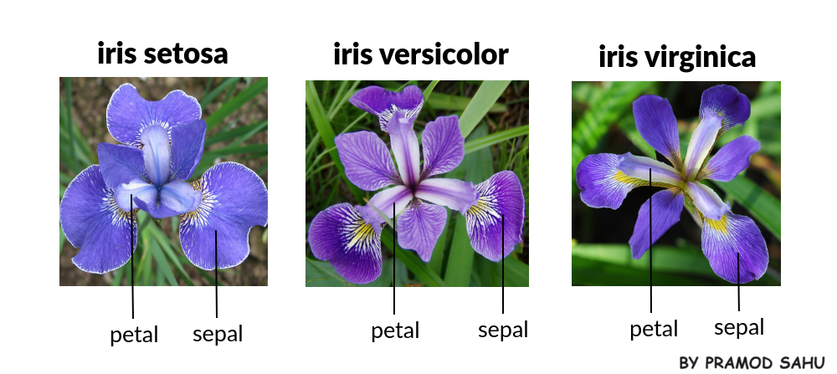
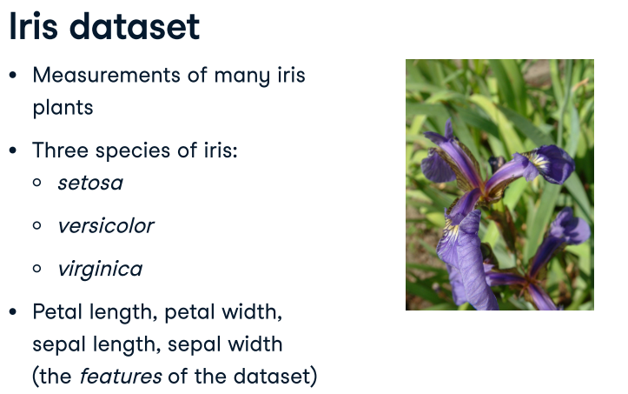
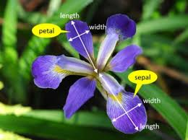
Data available from:
https://scikit-learn.org/stable/modules/generated/sklearn.datasets.load_iris.html

Slide 5
Arrays, features and samples
2D NumPy array
  Throughout this topic, datasets like this will be written as two-dimensional NumPy arrays.
Columns are measurements (the features)
  The columns of the array will correspond to the features.
Rows represent iris plants (the samples)
  The measurements for individual plants are the samples of the dataset. These correspond to rows of the array.

Slide 6
Iris data is 4-dimensional
The samples of the iris dataset have four measurements, and so correspond to points in a four-dimensional space.
Dimension = number of features.
This is the dimension of the dataset. Dimension too high to visualize!!
We can't visualize four dimensions directly, but by using unsupervised learning techniques, we can still gain insight.

Slide 7
K-means clustering
In this chapter, we'll cluster these samples using k-means clustering. Finds clusters of samples.
k-means finds a specified number of clusters in the samples.
  Number of clusters must be specified.
It's implemented in the scikit-learn or "sklearn" library.
Let's see k-means in action on some samples from the iris dataset.

Slide 8
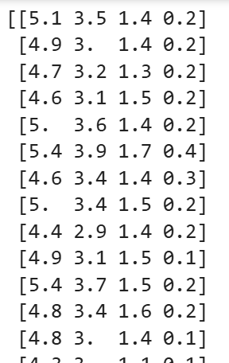
from sklearn.datasets import load_iris
iris = load_iris()
print(iris.data)

Slide 9
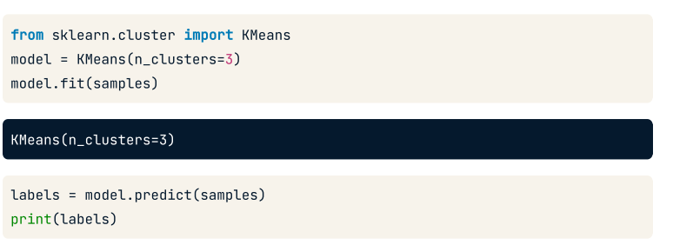
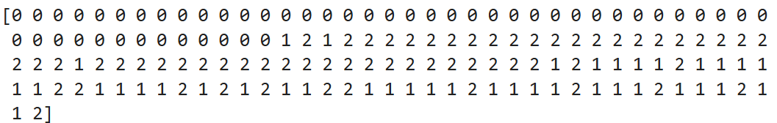
from sklearn.datasets import load_iris
from sklearn.cluster import Kmeans
iris = load_iris()
print(iris.data)
model = KMeans(n_clusters = 3)
model.fit(iris.data)
labels = model.predict(iris.data)
print(labels)

Slide 10
Cluster labels for new samples
New samples can be assigned to existing clusters.
k-means remembers the mean of each cluster (the "centroids").
Finds the nearest centroid to each new sample
new_samples = np.array([[5.7, 4.4, 1.5, 0.4],
[6.5, 3.0, 5.5, 1.8],
[5.8, 2.7, 5.1, 1.9]])
new_labels = model.predict(new_samples)
print(new_labels)
[0 1 2]

Slide 11
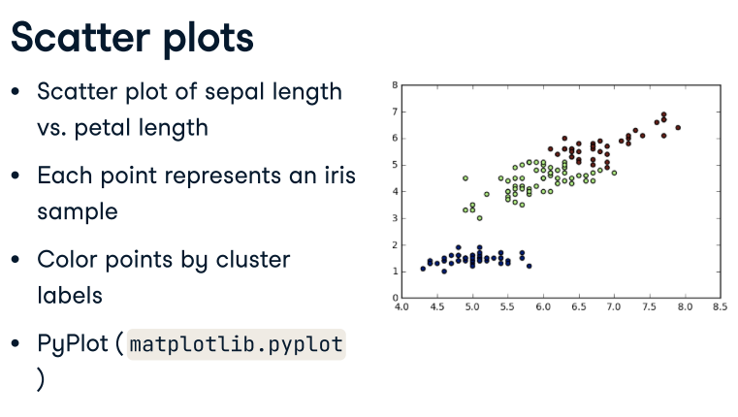

Slide 12
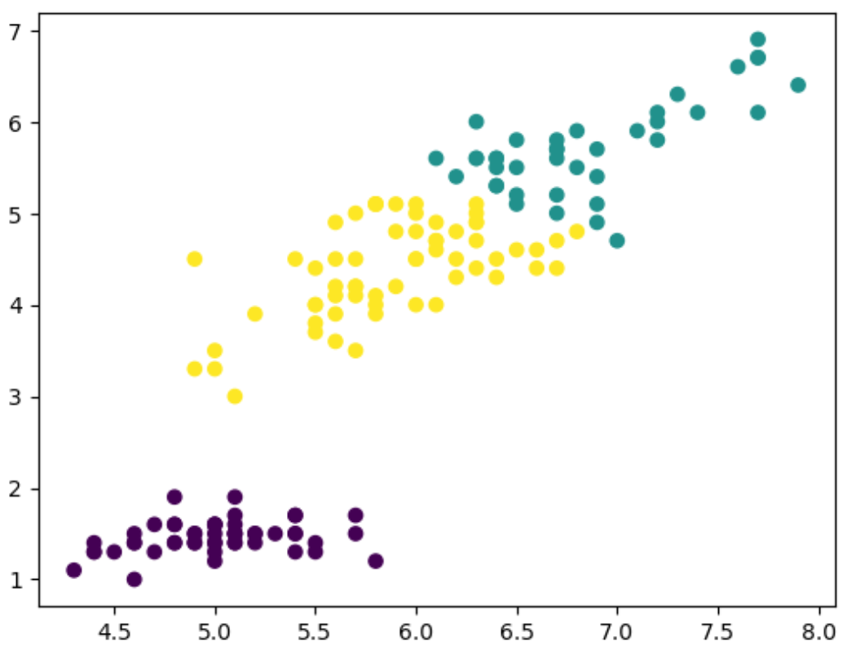
import matplotlib.pyplot as plt
xs = iris.data[:,0] #sepal length
ys = iris.data[:,2] #petal length
plt.scatter(xs, ys, c= labels)
plt.show()

Slide 13
Practice – How many clusters
You are given an array of points of size 300x2, where each row gives the (x, y) coordinates of a point on a map. Load data from ponits.csv to pointsDF DataFrame.
Convert pointsDF to NumPy array, namely points. How? Google…
Make a scatter plot of these points, and use the scatter plot to guess how many clusters there are.
Create an array called xs that contains the values of points[:,0] - that is, column 0 of points.
Create an array called ys that contains the values of points[:,1] - that is, column 1 of points.
Make a scatter plot by passing xs and ys to the plt.scatter() function.
Call the plt.show() function to show your plot.
How many clusters do you see?

Slide 14
Clustering 2D points
From the scatter plot of the previous exercise, you saw that the points seem to separate into 3 clusters.
You'll now create a KMeans model to find 3 clusters, and fit it to the data points from the previous exercise.
After the model has been fit, you'll obtain the cluster labels for some new points using the .predict() method.
You are given an array new_points.

Slide 15
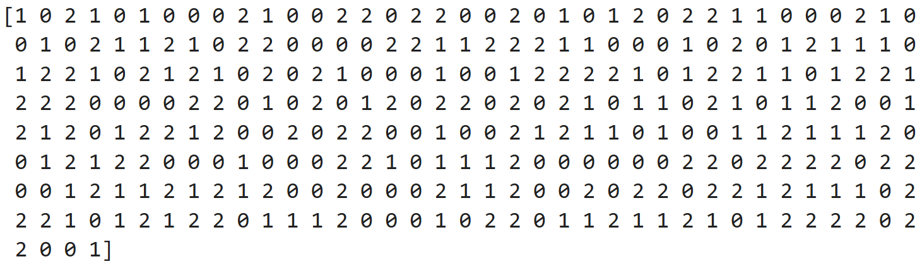
Train and fit the model
Import KMeans from sklearn.cluster.
Load data from new_points.csv and convert to NumPy array
Using KMeans(), create a KMeans instance called model to find 3 clusters. To specify the number of clusters, use the n_clusters keyword argument.
Use the .fit() method of model to fit the model to the array of points.
Use the .predict() method of model to predict the cluster labels of new_points, assigning the result to labels.
Hit submit to see the cluster labels of new_points.

Slide 16
Inspect your cluster
A solution to the previous exercise has already run, so new_points is an array of points, and labels is the array of their cluster labels.
Import matplotlib.pyplot as plt.
Assign column 0 of new_points to xs, and column 1 of new_points to ys.
Make a scatter plot of xs and ys, specifying the c=labels keyword arguments to color the points by their cluster label. Also specify alpha=0.5.
Compute the coordinates of the centroids using the .cluster_centers_ attribute of the model.
  centroids = model.cluster_centers_
Assign column 0 of centroids to centroids_x, and column 1 of centroids to centroids_y.
Make a scatter plot of centroids_x and centroids_y, using 'D' (a diamond) as a marker by specifying the marker parameter.
  Set the size of the markers to be 50 using s=50.

Slide 17
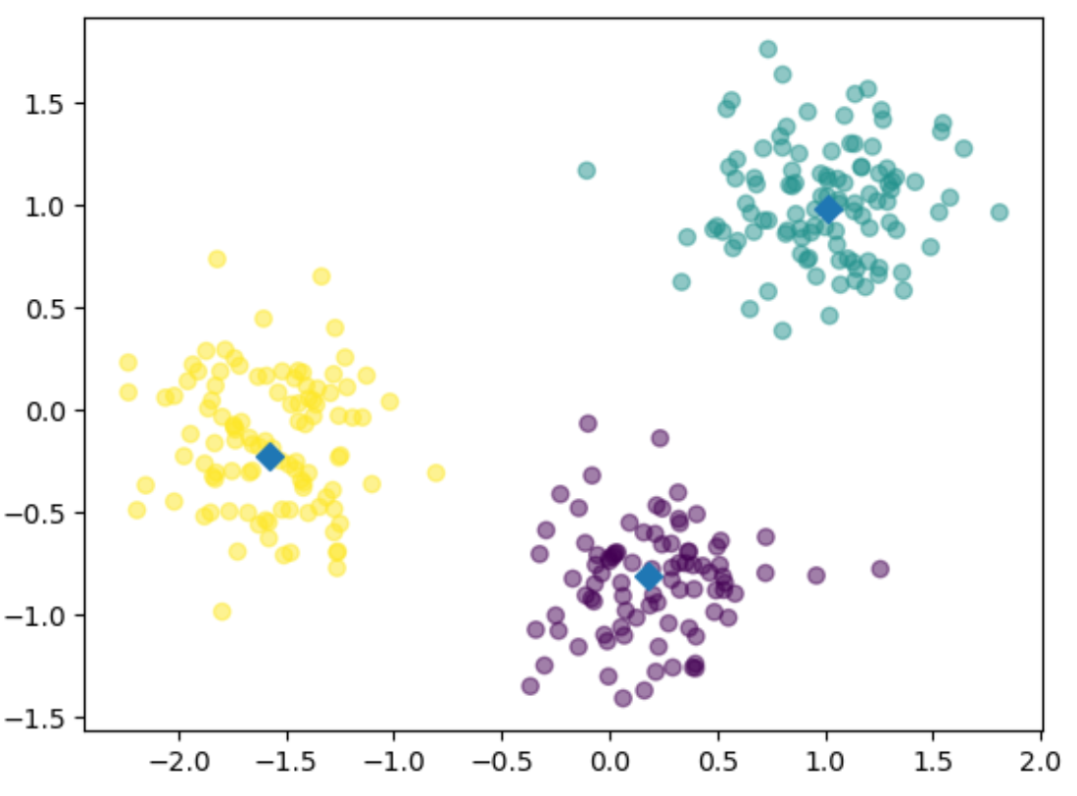

Slide 18
Evaluating a clustering
Can check correspondence with e.g. iris species.
... but what if there are no species to check against?
Measure the quality of a clustering.
Informs choice of how many clusters to look for

Slide 19
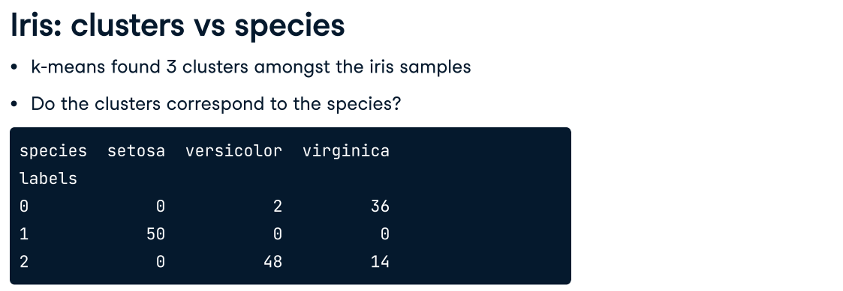
The table shows the number of samples that have each possible cluster label/species combination. For example, we see that cluster 1 corresponds perfectly with the species setosa.
On the other hand, while cluster 0 contains mainly virginica samples, there are also some virginica samples in cluster 2.

Slide 20
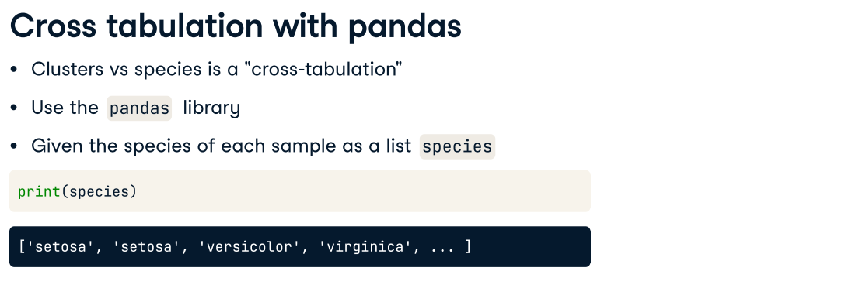
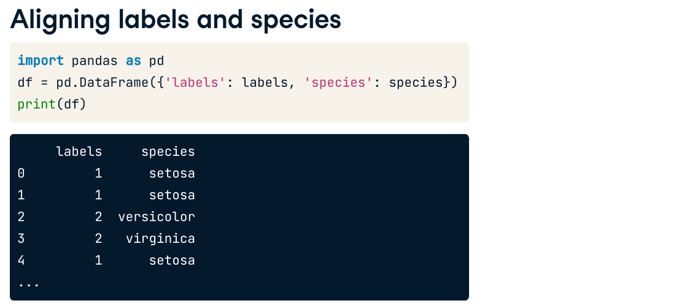

Slide 22
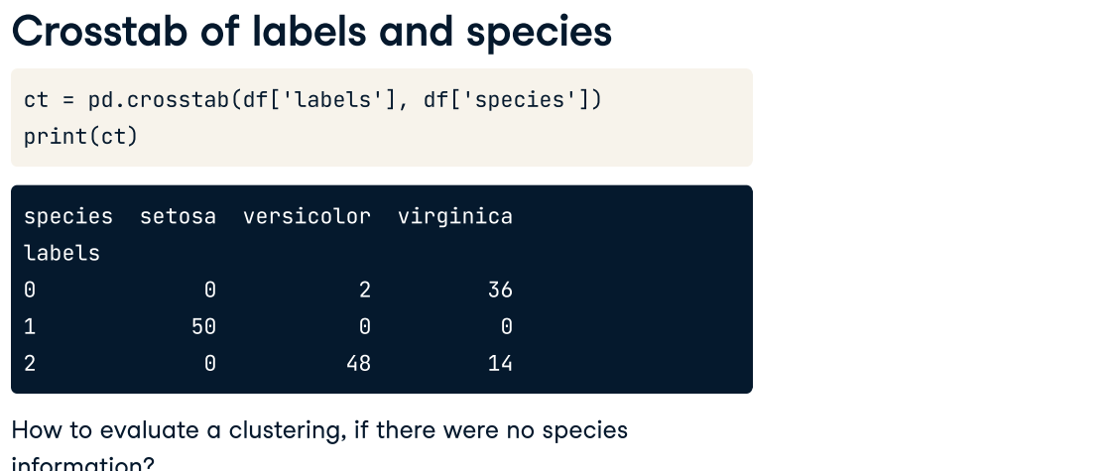

Slide 23
Measuring clustering quality
Using only samples and their cluster labels.
A good clustering has tight clusters.
Samples in each cluster bunched together

Slide 24
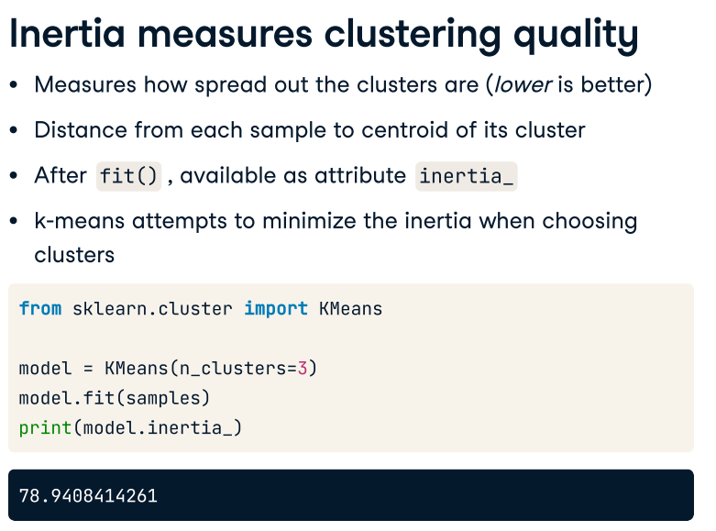
Note: samples = iris.data
So replace samples with iris.data in this code.

Slide 25
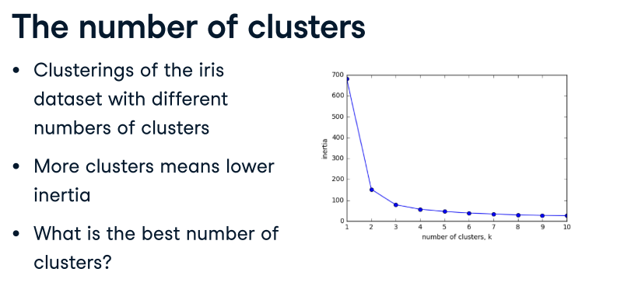

Slide 26
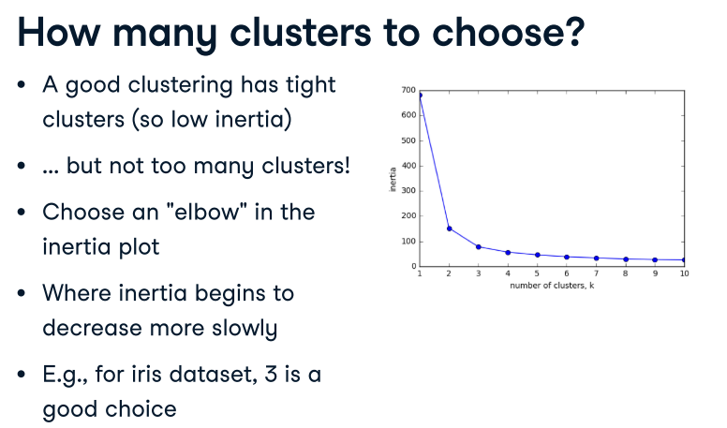

Slide 27
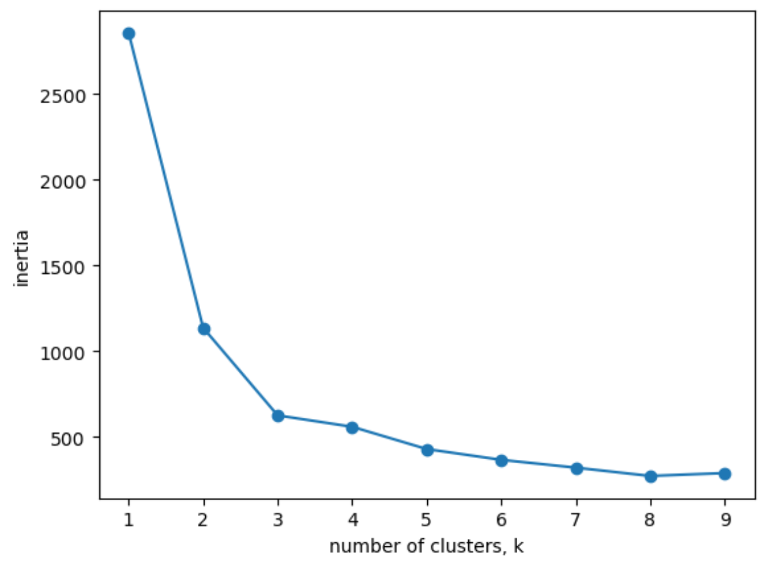
How many clusters of grain?
You learned how to choose a good number of clusters for a dataset using the k-means inertia graph. You are given an array of samples (loaded from seeds.csv and do not forget to convert the data into NumPy array) containing the measurements (such as area, perimeter, length, and several others) of samples of grain. What's a good number of clusters in this case?
For each of the given values of k (1 to 10), perform the following steps:
Create a KMeans instance called model with k clusters.
Fit the model to the grain data samples.
Append the value of the inertia_ attribute of model to the list inertias.
Then plot!
seedsDF = pd.read_csv('seeds.csv’)
seeds = seedsDF.to______ #convert to numpy
ks = range(1, 10)
inertias = []
for k in ks: # Create a KMeans instance with k clusters: model
model = ___________
# Fit model to seeds
model.fit(__________)
# Append the inertia to the list of inertias inertias.__________(model.inertia_)
# Plot ks vs inertias
plt.plot(ks, inertias, '-o’)
plt.xlabel('number of clusters, k’)
plt.ylabel('inertia’)
plt.xticks(ks)
plt.show()

Slide 28
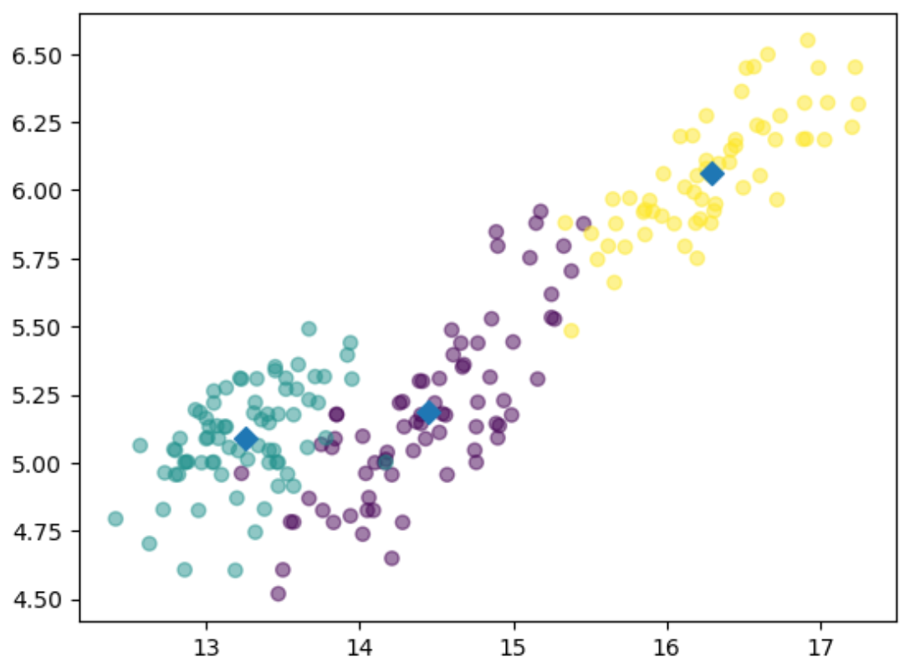
Seeds comprise seven geometric parameters of wheat kernels were measured:
1. area A, #column 0
2. perimeter P,
3. compactness C = 4*pi*A/P^2,
4. length of kernel,
5. width of kernel,
6. asymmetry coefficient
7. length of kernel groove. #column 6
Do the scatter plot.
Try with different combinations of values for x and y.
In the given plot, x is the area, and y is the length of the kernel groove.

Slide 29
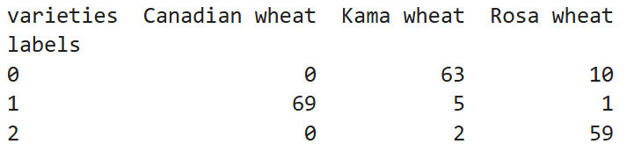
varieties = ['Kama wheat', 'Kama wheat', 'Kama wheat', 'Kama wheat', 'Kama wheat', 'Kama wheat', 'Kama wheat', 'Kama wheat', 'Kama wheat', 'Kama wheat', 'Kama wheat', 'Kama wheat', 'Kama wheat', 'Kama wheat', 'Kama wheat', 'Kama wheat', 'Kama wheat', 'Kama wheat', 'Kama wheat', 'Kama wheat', 'Kama wheat', 'Kama wheat', 'Kama wheat', 'Kama wheat', 'Kama wheat', 'Kama wheat', 'Kama wheat', 'Kama wheat', 'Kama wheat', 'Kama wheat', 'Kama wheat', 'Kama wheat', 'Kama wheat', 'Kama wheat', 'Kama wheat', 'Kama wheat', 'Kama wheat', 'Kama wheat', 'Kama wheat', 'Kama wheat', 'Kama wheat', 'Kama wheat', 'Kama wheat', 'Kama wheat', 'Kama wheat', 'Kama wheat', 'Kama wheat', 'Kama wheat', 'Kama wheat', 'Kama wheat', 'Kama wheat', 'Kama wheat', 'Kama wheat', 'Kama wheat', 'Kama wheat', 'Kama wheat', 'Kama wheat', 'Kama wheat', 'Kama wheat', 'Kama wheat', 'Kama wheat', 'Kama wheat', 'Kama wheat', 'Kama wheat', 'Kama wheat', 'Kama wheat', 'Kama wheat', 'Kama wheat', 'Kama wheat', 'Kama wheat', 'Rosa wheat', 'Rosa wheat', 'Rosa wheat', 'Rosa wheat', 'Rosa wheat', 'Rosa wheat', 'Rosa wheat', 'Rosa wheat', 'Rosa wheat', 'Rosa wheat', 'Rosa wheat', 'Rosa wheat', 'Rosa wheat', 'Rosa wheat', 'Rosa wheat', 'Rosa wheat', 'Rosa wheat', 'Rosa wheat', 'Rosa wheat', 'Rosa wheat', 'Rosa wheat', 'Rosa wheat', 'Rosa wheat', 'Rosa wheat', 'Rosa wheat', 'Rosa wheat', 'Rosa wheat', 'Rosa wheat', 'Rosa wheat', 'Rosa wheat', 'Rosa wheat', 'Rosa wheat', 'Rosa wheat', 'Rosa wheat', 'Rosa wheat', 'Rosa wheat', 'Rosa wheat', 'Rosa wheat', 'Rosa wheat', 'Rosa wheat', 'Rosa wheat', 'Rosa wheat', 'Rosa wheat', 'Rosa wheat', 'Rosa wheat', 'Rosa wheat', 'Rosa wheat', 'Rosa wheat', 'Rosa wheat', 'Rosa wheat', 'Rosa wheat', 'Rosa wheat', 'Rosa wheat', 'Rosa wheat', 'Rosa wheat', 'Rosa wheat', 'Rosa wheat', 'Rosa wheat', 'Rosa wheat', 'Rosa wheat', 'Rosa wheat', 'Rosa wheat', 'Rosa wheat', 'Rosa wheat', 'Rosa wheat', 'Rosa wheat', 'Rosa wheat', 'Rosa wheat', 'Rosa wheat', 'Rosa wheat', 'Canadian wheat', 'Canadian wheat', 'Canadian wheat', 'Canadian wheat', 'Canadian wheat', 'Canadian wheat', 'Canadian wheat', 'Canadian wheat', 'Canadian wheat', 'Canadian wheat', 'Canadian wheat', 'Canadian wheat', 'Canadian wheat', 'Canadian wheat', 'Canadian wheat', 'Canadian wheat', 'Canadian wheat', 'Canadian wheat', 'Canadian wheat', 'Canadian wheat', 'Canadian wheat', 'Canadian wheat', 'Canadian wheat', 'Canadian wheat', 'Canadian wheat', 'Canadian wheat', 'Canadian wheat', 'Canadian wheat', 'Canadian wheat', 'Canadian wheat', 'Canadian wheat', 'Canadian wheat', 'Canadian wheat', 'Canadian wheat', 'Canadian wheat', 'Canadian wheat', 'Canadian wheat', 'Canadian wheat', 'Canadian wheat', 'Canadian wheat', 'Canadian wheat', 'Canadian wheat', 'Canadian wheat', 'Canadian wheat', 'Canadian wheat', 'Canadian wheat', 'Canadian wheat', 'Canadian wheat', 'Canadian wheat', 'Canadian wheat', 'Canadian wheat', 'Canadian wheat', 'Canadian wheat', 'Canadian wheat', 'Canadian wheat', 'Canadian wheat', 'Canadian wheat', 'Canadian wheat', 'Canadian wheat', 'Canadian wheat', 'Canadian wheat', 'Canadian wheat', 'Canadian wheat', 'Canadian wheat', 'Canadian wheat', 'Canadian wheat', 'Canadian wheat', 'Canadian wheat', 'Canadian wheat']
#To see cross-tabluation
# Create a KMeans model with 3 clusters: model
model = KMeans(n_clusters=3)
# Use fit_predict to fit model and obtain cluster labels: labels
labels = model.fit_predict(samples)
# Create a DataFrame with clusters and varieties as columns: df
df = pd.DataFrame({'labels': labels, 'varieties': varieties})
# Create crosstab: ct
ct = pd.crosstab(df['labels'], df['varieties'])
# Display ct
print(ct)
Note: the values in the varieties array is not the exact match with the labels obtained from the model. This is provided as an example how to see the cross-tabulation.

Slide 30
Transforming features for better clustering

Slide 31
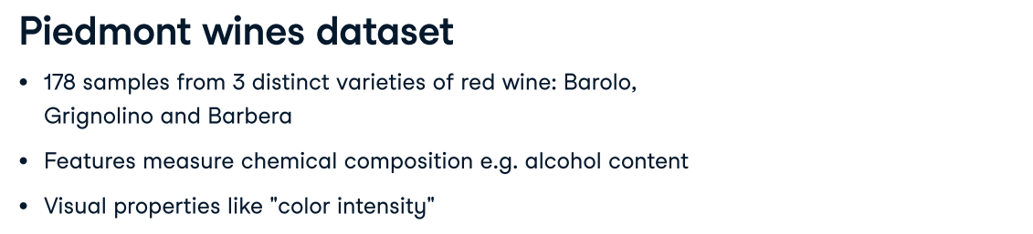
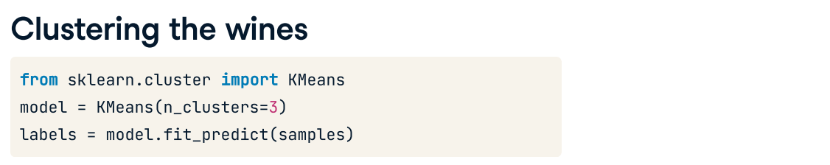

Slide 32
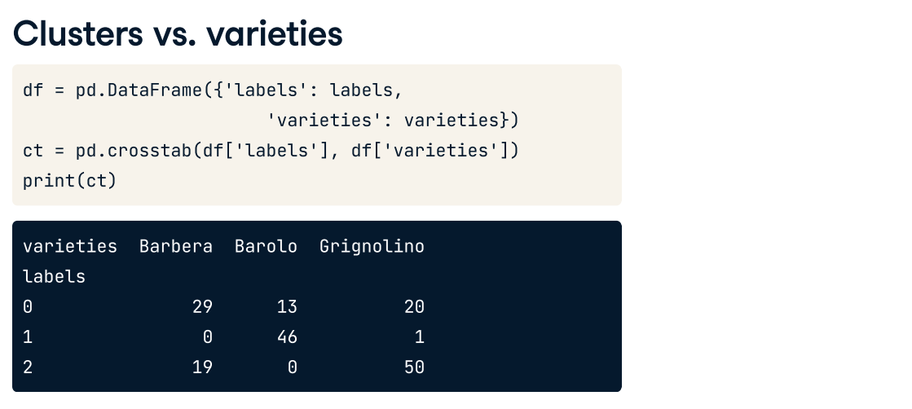

Slide 33
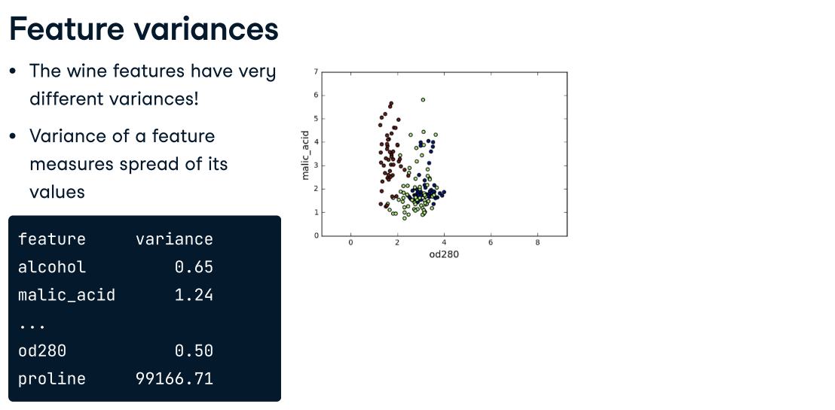

Slide 34
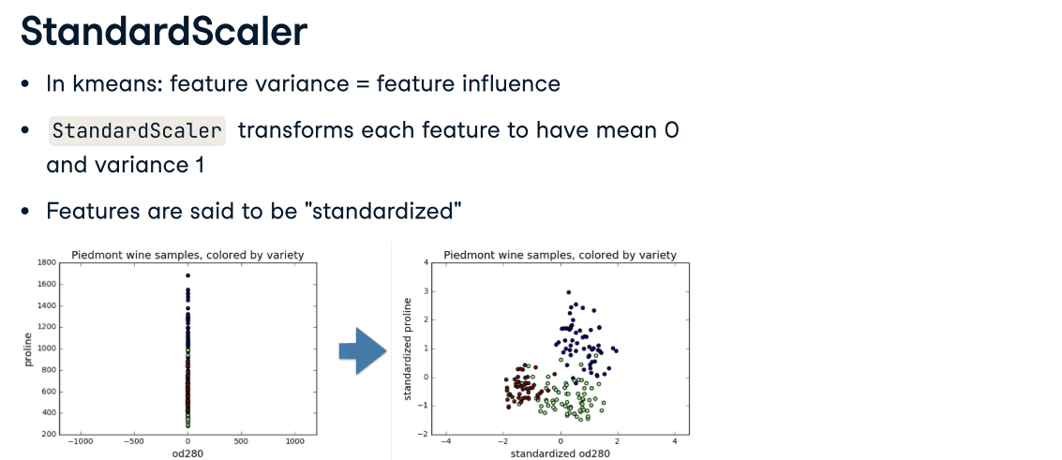

Slide 35
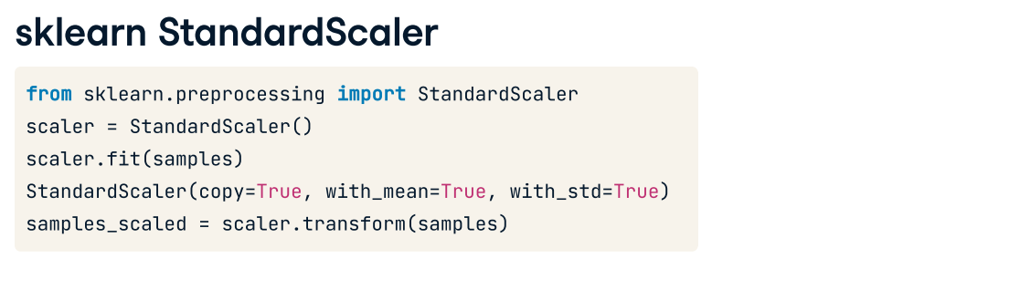
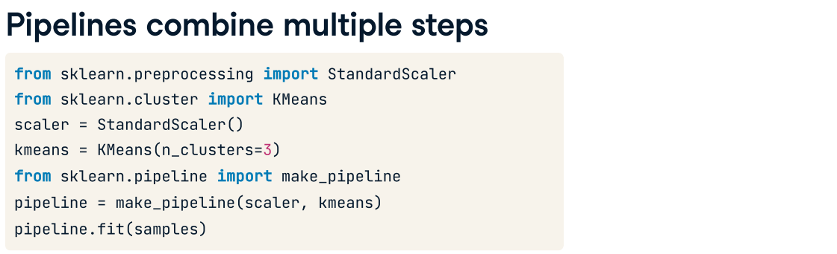

Slide 36
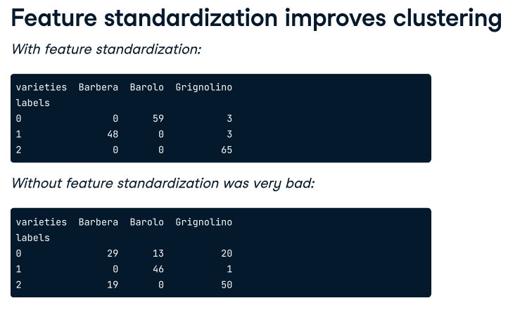

Slide 37
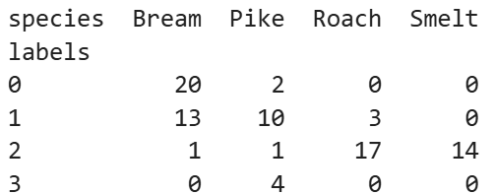
#Clustering without standardization
fish = pd.read_csv('fish.csv', header = None)
samples=fish.drop(0, axis=1)
samples.head()
kmeans = KMeans(n_clusters=4)
# Fit the pipeline to samples
kmeans.fit(samples)
# Calculate the cluster labels: labels
labels = kmeans.predict(samples)
# Create a DataFrame with labels and species as columns: df
df = pd.DataFrame({'labels': labels, 'species': species})
# Create crosstab: ct
ct = pd.crosstab(df['labels'], df['species’])
# Display ct
print(ct)
species = ['Bream', 'Bream', 'Bream', 'Bream', 'Bream', 'Bream', 'Bream', 'Bream', 'Bream', 'Bream', 'Bream', 'Bream', 'Bream', 'Bream', 'Bream', 'Bream', 'Bream', 'Bream', 'Bream', 'Bream', 'Bream', 'Bream', 'Bream', 'Bream', 'Bream', 'Bream', 'Bream', 'Bream', 'Bream', 'Bream', 'Bream', 'Bream', 'Bream', 'Bream', 'Roach', 'Roach', 'Roach', 'Roach', 'Roach', 'Roach', 'Roach', 'Roach', 'Roach', 'Roach', 'Roach', 'Roach', 'Roach', 'Roach', 'Roach', 'Roach', 'Roach', 'Roach', 'Roach', 'Roach', 'Smelt', 'Smelt', 'Smelt', 'Smelt', 'Smelt', 'Smelt', 'Smelt', 'Smelt', 'Smelt', 'Smelt', 'Smelt', 'Smelt', 'Smelt', 'Smelt', 'Pike', 'Pike', 'Pike', 'Pike', 'Pike', 'Pike', 'Pike', 'Pike', 'Pike', 'Pike', 'Pike', 'Pike', 'Pike', 'Pike', 'Pike', 'Pike', 'Pike']

Slide 38
Scaling fish data for clustering
Each row represents an individual fish. The measurements, such as weight in grams, length in centimeters, and the percentage ratio of height to length, have very different scales.
In order to cluster this data effectively, you'll need to standardize these features first. In this exercise, you'll build a pipeline to standardize and cluster the data.
Load data from fish.csv. Drop a necessary column.
Import:
  make_pipeline from sklearn.pipeline.
  StandardScaler from sklearn.preprocessing.
  KMeans from sklearn.cluster.
Create an instance of StandardScaler called scaler.
Create an instance of KMeans with 4 clusters called kmeans.
Create a pipeline called pipeline that chains scaler and means. To do this, you just need to pass them in as arguments to make_pipeline().

Slide 39
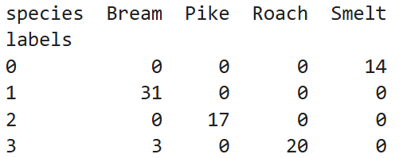
Scaling fish data for clustering (cont.)
Fit the pipeline to the fish measurements samples.
Obtain the cluster labels for samples by using the .predict() method of pipeline.
Using pd.DataFrame(), create a DataFrame df with two columns named 'labels' and 'species', using labels and species, respectively, for the column values.
Using pd.crosstab(), create a cross-tabulation ct of df['labels'] and df['species'].

Slide 40
Visualize the clusters

Slide 41
pointsDF = pd.read_csv('points.csv', index_col = 0)
#print(pointsDF.head())
points = pointsDF.to_numpy()
#print(points)
xs = points[:,0]
ys = points[:,1]
plt.scatter(xs,ys)plt.show()
npointsDF = pd.read_csv('new_points.csv', index_col = 0)
new_points = npointsDF.to_numpy()
# Import Kmeans
from sklearn.cluster import Kmeans
# Create a KMeans instance with 3 clusters: model
model = KMeans(n_clusters=3)
# Fit model to points
model.fit(points)
# Determine the cluster labels of new_points: labels
labels = model.predict(new_points)
# Print cluster labels of new_points
print(labels)
#print(new_points)
# Import pyplot
from matplotlib import pyplot as plt
# Assign the columns of new_points: xs and ys
xs = new_points[:,0]
ys = new_points[:,1]
# Make a scatter plot of xs and ys, using labels to define the colors
plt.scatter(xs, ys, c=labels, alpha=0.5)
# Assign the cluster centers: centroids
centroids = model.cluster_centers_
# Assign the columns of centroids:
centroids_x, centroids_y
centroids_x = centroids[:,0]
centroids_y = centroids[:,1]
# Make a scatter plot of centroids_x and centroids_y
plt.scatter(centroids_x, centroids_y, marker='D', s=50)
plt.show()

Slide 42
seedsDF = pd.read_csv('seeds.csv’)
seeds = seedsDF.to_numpy()
ks = range(1, 10)
inertias = []
for k in ks:
# Create a KMeans instance with k clusters:model
model = KMeans(n_clusters=k)
# Fit model to samples
model.fit(seeds)
# Append the inertia to the list of inertias inertias.append(model.inertia_)
# Plot ks vs inertias
plt.plot(ks, inertias, '-o’)
plt.xlabel('number of clusters, k’)
plt.ylabel('inertia’)
plt.xticks(ks)
plt.show()

Slide 43
model = KMeans(n_clusters=3)
# Fit model to samples
model.fit(seeds)
labels = model.predict(seeds)
xs = seeds[:,0]
ys = seeds[:,2]
print(seeds.shape)
print(labels.shape)
# Make a scatter plot of xs and ys, using labels to define the colors
plt.scatter(xs, ys, c=labels, alpha=0.5)
# Assign the cluster centers: centroids
centroids = model.cluster_centers_
print(centroids)
# Assign the columns of centroids: centroids_x, centroids_y
centroids_x = centroids[:,0]
centroids_y = centroids[:,1]
# Make a scatter plot of centroids_x and centroids_y
plt.scatter(centroids_x, centroids_y, marker='D', s=50)
plt.show()
# Create a KMeans model with 3 clusters: model
model = KMeans(n_clusters=3)
# Use fit_predict to fit model and obtain cluster labels: labels
labels = model.fit_predict(samples)
# Create a DataFrame with clusters and varieties as columns: df
df = pd.DataFrame({'labels': labels, 'varieties': varieties})
# Create crosstab: ct
ct = pd.crosstab(df['labels'], df['varieties'])
# Display ct
print(ct)

Slide 44
# Import pandas
# Perform the necessary imports
from sklearn.pipeline import make_pipeline
from sklearn.preprocessing import StandardScaler
from sklearn.cluster import KMeans
# Create scaler: scaler
scaler = StandardScaler()
# Create KMeans instance: kmeans
kmeans = KMeans(n_clusters=4)
# Create pipeline: pipeline
pipeline = make_pipeline(scaler, kmeans)
# Fit the pipeline to samples
pipeline.fit(samples)
# Calculate the cluster labels: labels
labels = pipeline.predict(samples)
# Create a DataFrame with labels and species as columns: df
df = pd.DataFrame({'labels': labels, 'species': species})
# Create crosstab: ct
ct = pd.crosstab(df['labels'], df['species'])
# Display ct
print(ct)

